Slide 1
Using ErWin

Slide 2
Getting Started
To open, choose the following path:
Program files -> CA -> erWin->ERWin Data Modeler
OR
Program files ->erWin ->ERWin Data Modeler
(depends on the version installed)
Check in the lab.
This may be slightly different.
ERWin is installed on all machines.

Slide 3
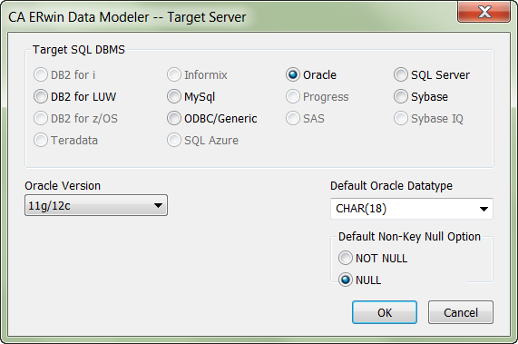
Setting Target Database
ERWin can generate SQL to work with many different DB implentations
You need to make sure that your Target Database is set correctly before generating your SQL
In Physical Model View Select Actions->Target Database

Slide 4
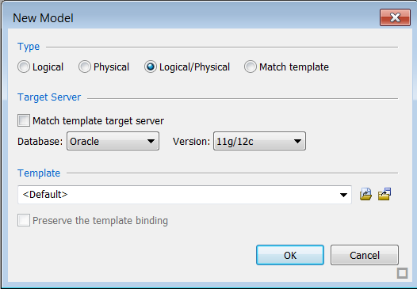
Selecting a Template
File -> New ->
Make sure you choose Logical/Physical
Make sure that the database is set to ORACLE and to the correct version 11g/12c

Slide 5
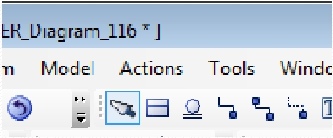
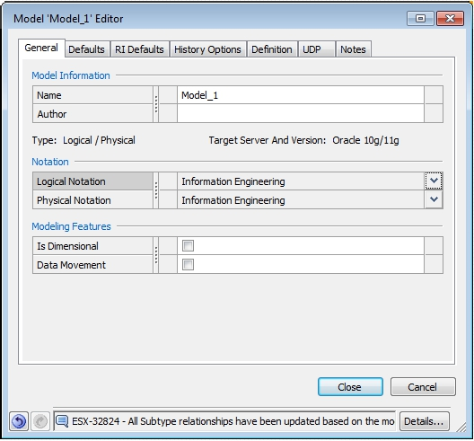
Notation
We use Information Engineering Notation
If your model has these icons under the Tools Menu You need to change the notation
Click Model ->Model Properties and change the value to Information Engineering Notation for both logical and physical
You need to change this notation if it shows up

Slide 6
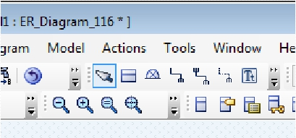
Notation
This will give us the crows feet notation. This is the notation we want to use
One-to-Many (identifying relationship)
Many-to-Many (Logical Model only)
One-to-Many (Non-identifying Relationship)

Slide 7
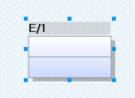
To add an entity
Click the 'Entity' icon on the top most toolbar
Then click on the canvas where you want it to appear
To name it, either type the name in the box (instead of E/a), or right click and choose Entity Properties

Slide 8
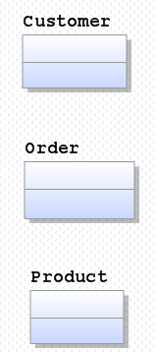
Exercise
Create three entities
Customer
Order
Product
To make life easier, create them one under the other

Slide 9
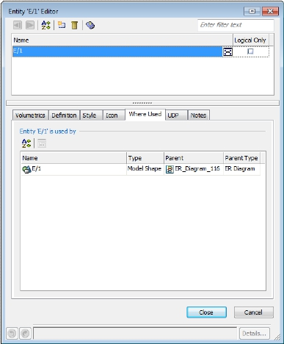
Naming Entities via Entity Properties
To name an entity, either type the name in the box (instead of E/a), or right click and choose Entity Properties
Type the name into the blue box and close.
Remember that entity names should be nouns.
Ideally they should be singular (e.g. Product not Products) and start with a capital letter.
There may be a need to include an adjective to differentiate in some cases e.g. Customer Order or Supplier Order
Click Close to make sure your changes are saved

Slide 10
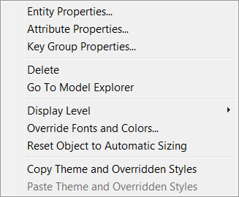
To add attributes
Rightclick on the entity you wish to add attributes for
Select Attribute Properties

Slide 11
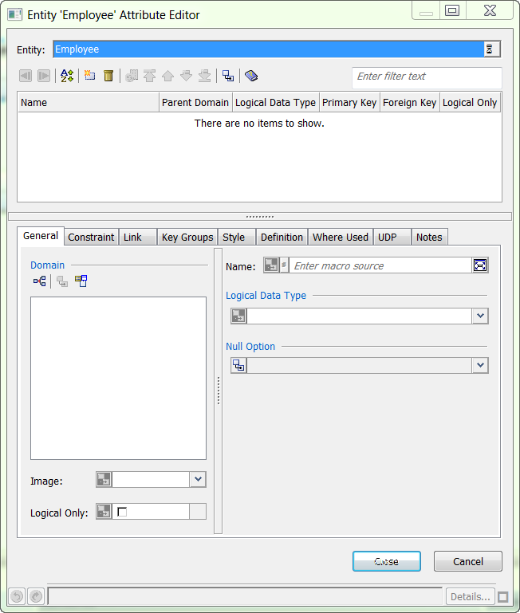
To add attributes
Click the new attribute icon

Slide 12
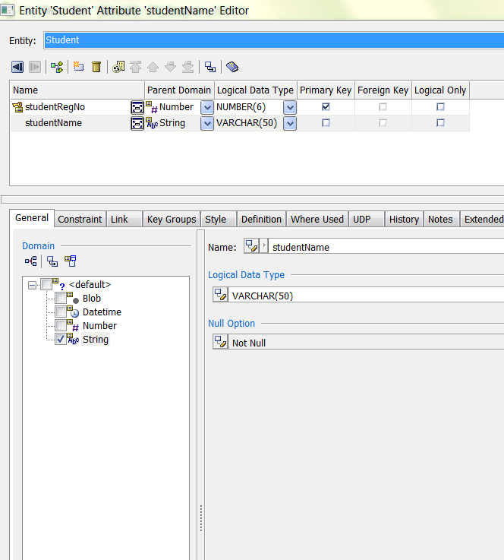
Adding Attributes
Enter the name of the attribute
Tick 'Primary key' (If this attribute is part of the PK)
Under the general tab
Choose the Domain
Then choose the datatype from the Logical Datatype section
Stick to the datatypes we have been using (number, varchar2, date)

Slide 13
Exercise
Enter the following attributes for our entities
Customer
customer_id Domain: Number, Datatype: number(5) – make this the primary key
customer_name Domain: String, Datatype: varchar2(50)
Order
order_id Domain: Number, Datatype: number(5) – make this the primary key
order_date Domain: DateTime, Datatype: Date
Product
product_id Domain: Number, Datatype: number(5) – make this the primary key
product_name Domain: Number, Datatype: number(5) – make this the primary key

Slide 14
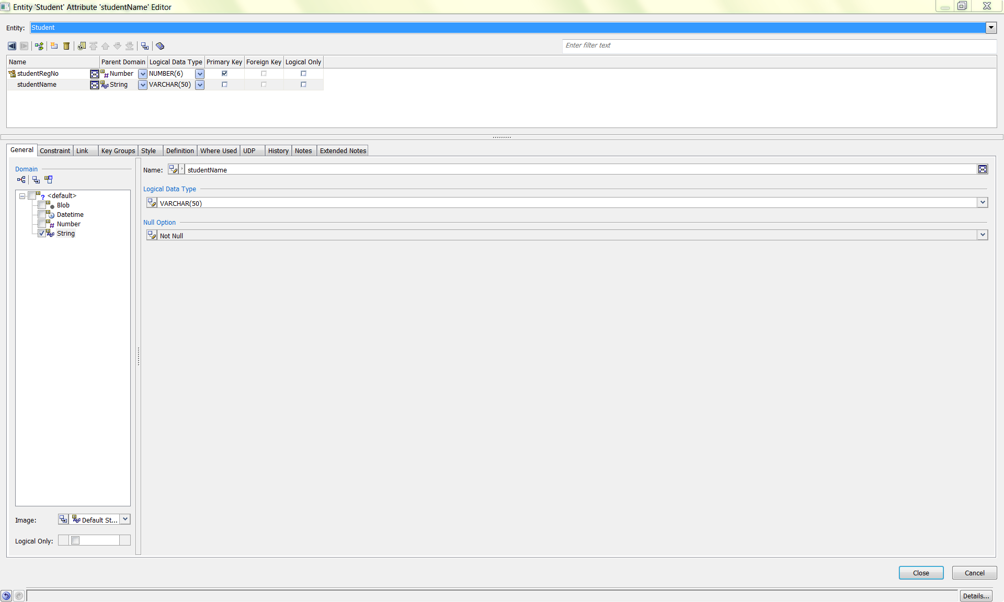
Adding Attributes
To set NOT NULL
Select the General Tab
Choose Not Null from the Null option drop down list

Slide 15
Adding Attributes
To make sure your attributes are saved on the diagram - you must click the close button at the bottom of the screen

Slide 16
Adding a Relationship
Need to choose relationship type:
Non-identifying
Identifying
Many to Many
Don’t worry about identifying and non-identifying at this point – for this week we will use non-identifying and many to many
Click on the master entity (1 side), then drag to the other in the relationship, the detail entity (many side) and release.
To view/change the properties of the relationship – double-click it.
Non-Identifying
Identifying
Many to many

Slide 17
Adding a Relationship
To add a one to many (1:M) relationship
Click on the relationship type
Click on the master entity (1 side), then drag to the other in the relationship, the detail entity (many side) and release.
Non-Identifying

Slide 18
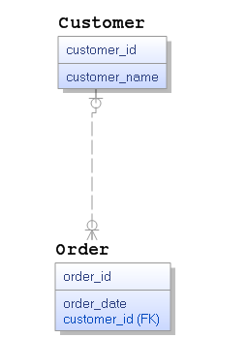
Exercise
Add a one to many relationship between Customer and Order
Click on the relationship type
Click on the master entity (Customer) (1 side), then drag to the other in the relationship (Order), the detail entity (many side) and release.
This adds a relationship between the two which means each customer can place many orders. It can also be read in reverse, each order is for one customer.
Non-Identifying
Notice that the customer_id is added to the Order entity by adding this relationship. This means we can for each order identify the name of the customer

Slide 19
Exercise
Notice that the customer_id is labelled (FK) – this means Foreign Key. It is called this because it is a key but not of this entity but another.
Using Foreign keys allows us to create links but also to make sure that data is consistent e.g. if we delete a customer, we should delete all their orders also – otherwise our data wouldn’t make sense.
Non-Identifying

Slide 20
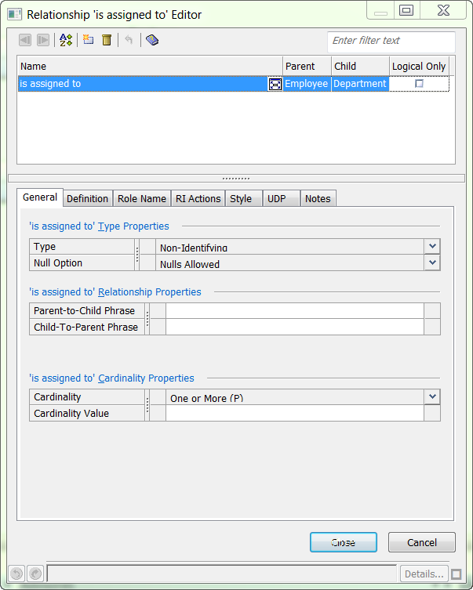
Adding Relationships
Use the 'non-identifying relationship' icon.
Here you can enter details about the cardinality.
NOTE: If the relationship is one to one, choose zero-to-one in the drop down box and then enter 1 in the cardinality value box

Slide 21
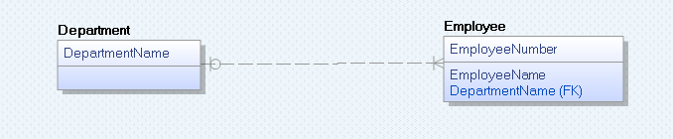
Adding Relationships
One department is assigned one or more employees
When you create the relationship, the attribute will be added to the child entity
If you want to, you can change the name afterward
If an attribute of this name already exists ERWin will ask you if you want to use it.

Slide 22
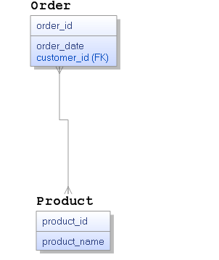
Exercise
Add a many to many relationship between Order and Product
Click on the relationship type
Click on the first entity (Order) then drag to the other in the relationship (Product) release.
This adds a relationship between the two which means each order logically can be for many products. It can also be read in reverse, each product can appear on many orders.
Many to Many

Slide 23
Logical to Physical
Notice in this case that no attributes are added to either Order or Product.
This is because logically an Order can be for many Products and a Product can appear in many Orders.
But we don’t have arrays in the relational model.
This is where the difference between logical and physical modelling comes into play.
Many to Many

Slide 24
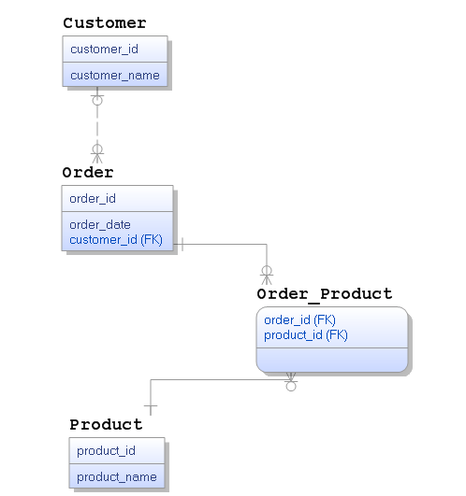
Logical to Physical
From the menu bar change the diagram type from Logical to Physical (select from the drop-down menu)
The model will now change and you will see a new entity appear Order_Product.
It has as a primary key the order_id and the product_id.
For each order there will be an instance of this for each product the order included.
We can add additional attributes here e.g. the number of each products ordered.

Slide 25
Exercise
From the menu bar change the diagram type from Logical to Physical (select from the drop-down menu)
The model will now change and you will see a new entity appear Order_Product.
It has as a primary key the order_id and the product_id.
For each order there will be an instance of this for each product the order included.
We can add additional attributes here e.g. the number of each products ordered.

Slide 26
Example
customer_id: 1
customer_name: Ms. Smith
Suppose we have populated our database with the data shown on the left.
Customer 1, Ms. Smith places an order for Product 1, iPhone 6S and Product 2 for iPhone 7 on the 1st June 2017
We need to now include the data to represent this order.
product_id: 1
product_name: iPhone 6S
product_id: 2
Product_name: iPhone 7

Slide 27
Example
order_id: 1
order_date: 01 June 2017 customer_id: 1
customer_name: Ms. Smith
It is our first order, so it is given an order_id of 1, the date is 1st June 2017, and it is being placed by customer_id 1
This order is for two products so we need two instances of Order_Product
Using our foreign keys we can use the values to locate additional information to support queries
order_id: 1
product_id: 1
order_id: 1
product_id: 2

Slide 28
Example
customer_id: 1
customer_name: Ms. Smith
order_id: 1
order_date: 01 June 2017 customer_id: 1
customer_name: Ms. Smith
Using our foreign keys we can use the values to locate additional information to support queries
So if we know an order number we can look at Order_Product and find the products that belong to that order and we can use the product_id to look up product details
If we know the order_id then we can use order_id to look up order details and then we can use customer_id to look up customer details.
order_id: 1
order_date: 01 June 2017 customer_id: 1
customer_name: Ms. Smith
order_id: 1
product_id: 1
order_id: 1
product_id: 2
order_id: 1
product_id: 1
order_id: 1
product_id: 2
product_id: 1
product_name: iPhone 6S
product_id: 2
Product_name: iPhone 7

Slide 29
Saving your model
You can save your model as a .erwin file
File -> Save as and make sure you save it somewhere you are easily access it

Slide 30
Downloading for ERWin home use
Request from
http://erwin.com/education/erwin-academic-program/academic-edition/
Make sure you use your DIT email address
Make sure you give my name Deirdre Lawless and the name of the module Databases I
Once you submit this request you will receive an email which will include a link to allow you to download ERwin and then to request a license
Please follow the instructions carefully to ensure you can install ERWin correctly

